Slide 1
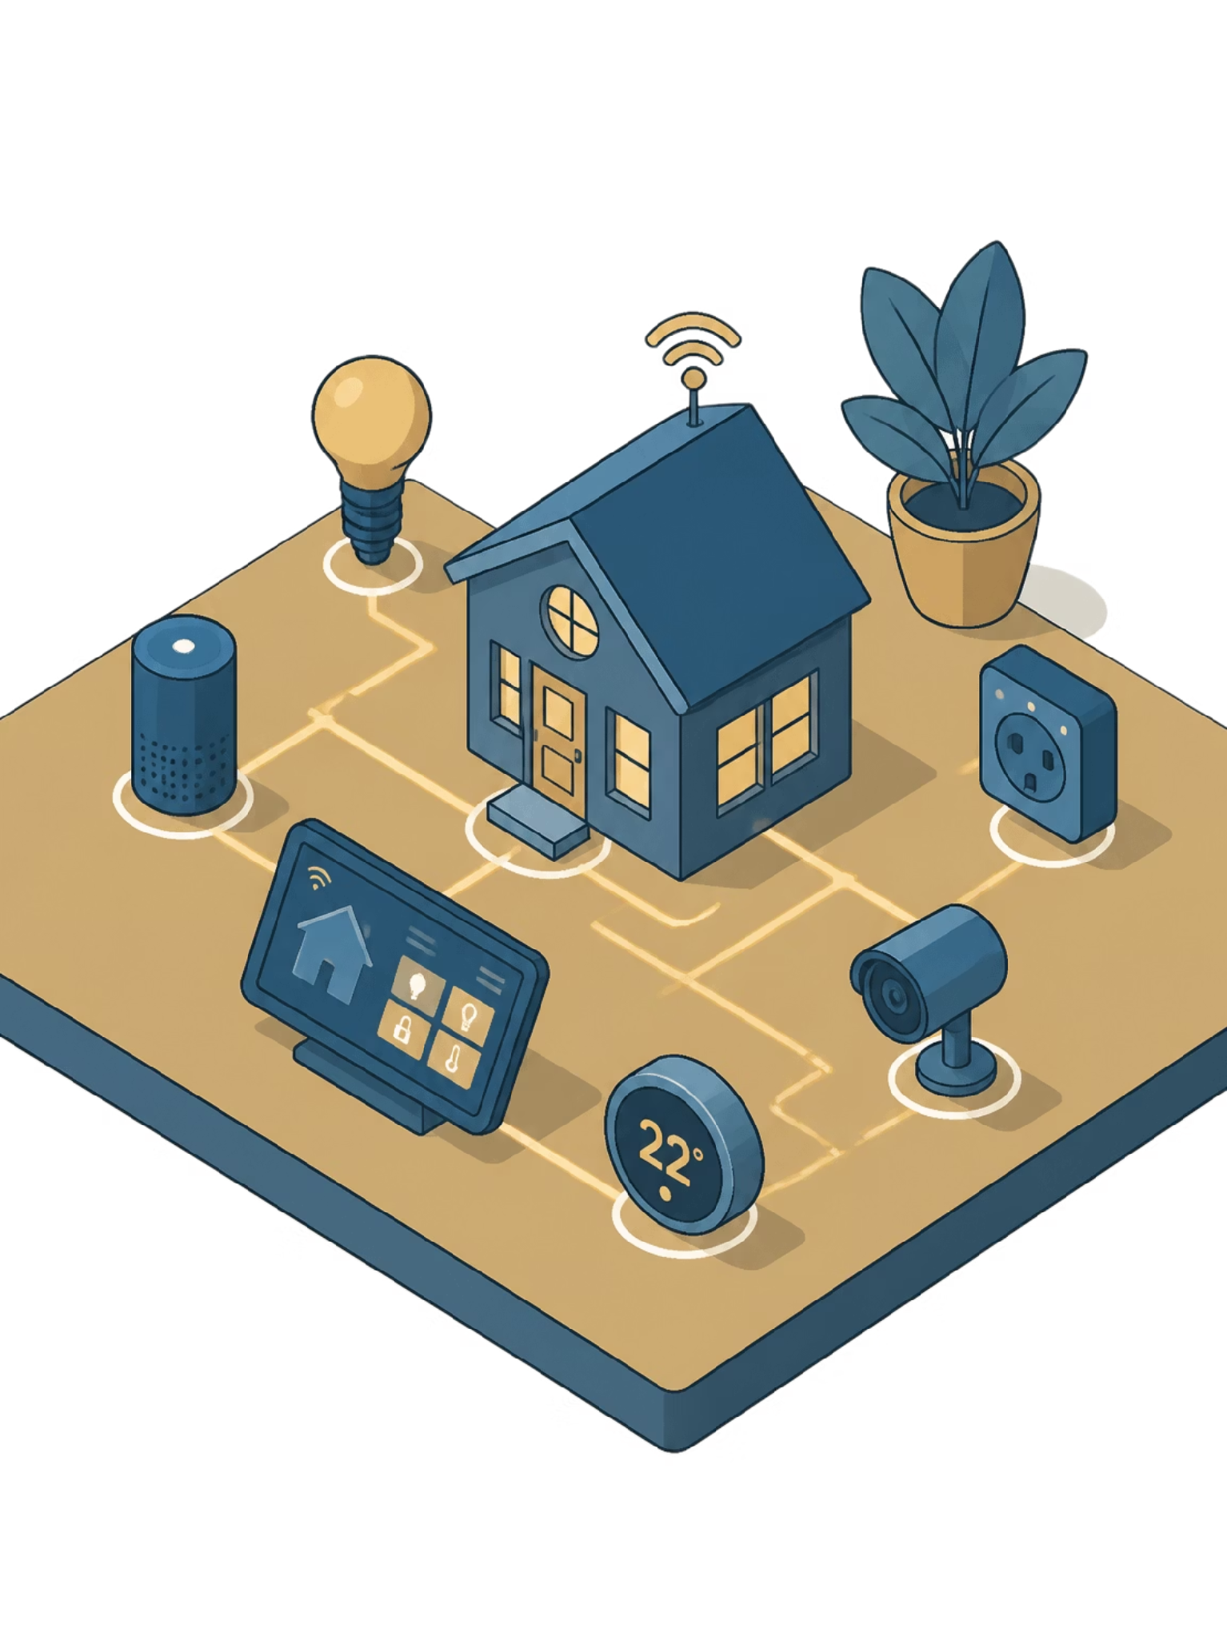



Smart Edge Home Security and Automation System
Project Proposal Presentation
Course Name
Members
Microprocessors and Microcontrollers Laboratory
Ratul - 0112330697
Mashurul - 0112330547
Supty - 0112330221
Sourav - 0112330638
Sadat - 0112330543
Group No
01

Slide 2
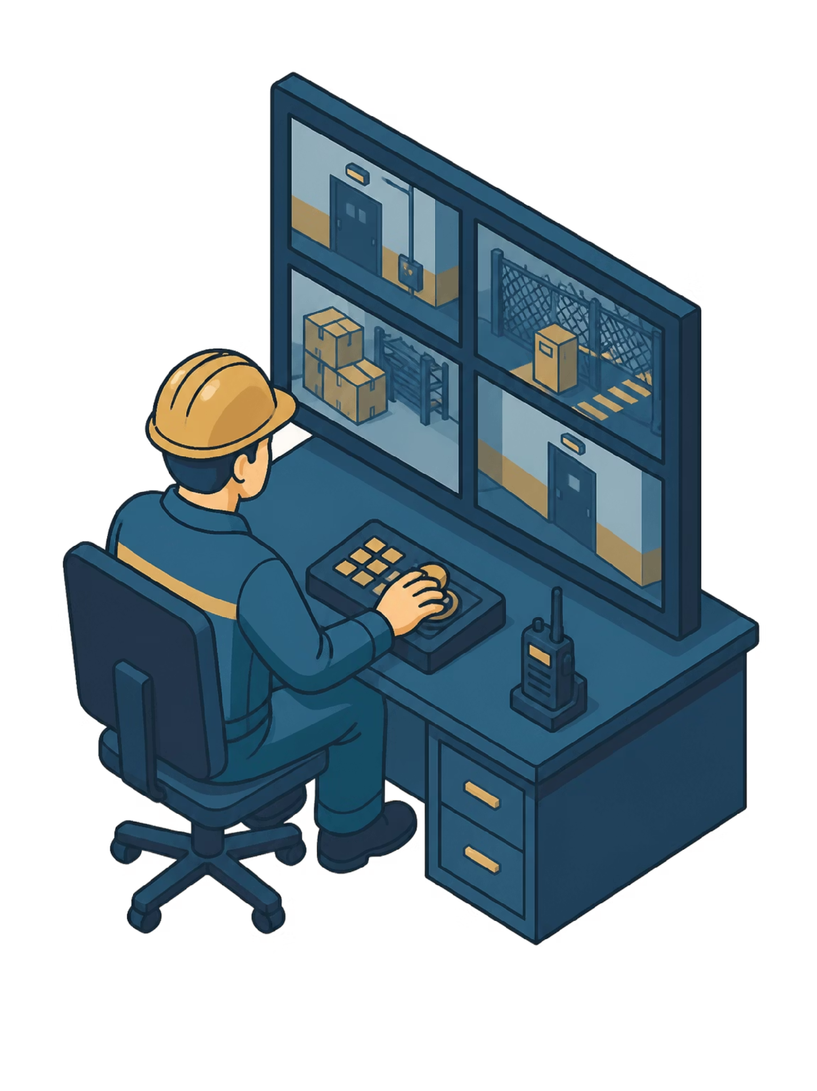


Why This Project?
The Problem
Growing need for safety, convenience, and energy efficiency in modern homes
Traditional systems rely on simple thresholds and lack intelligent monitoring
Our Solution
Combining embedded systems, edge AI, sensors, and wireless communication via Raspberry Pi 5
Societal Benefit
Cost-effective system for environmental safety, intelligent security, and centralized smart monitoring

Slide 3
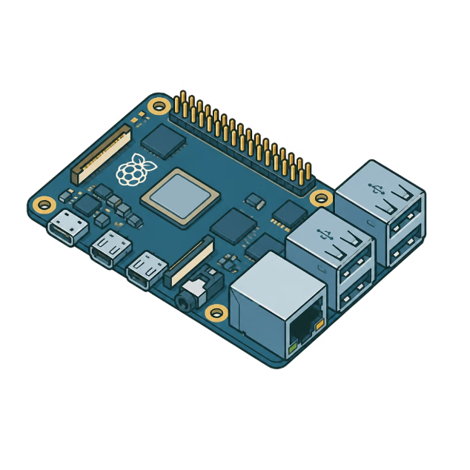

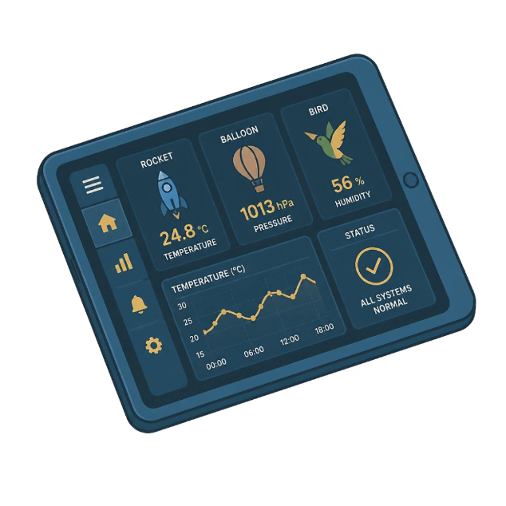
Introduction to the System
Embedded Core
Edge AI
Remote Monitoring
Raspberry Pi 5-based system designed to automate and secure a small home environment
Local AI for person detection — no cloud dependency, real-time on-device inference
Real-time wireless dashboard for live data, alerts, and system control

Slide 4
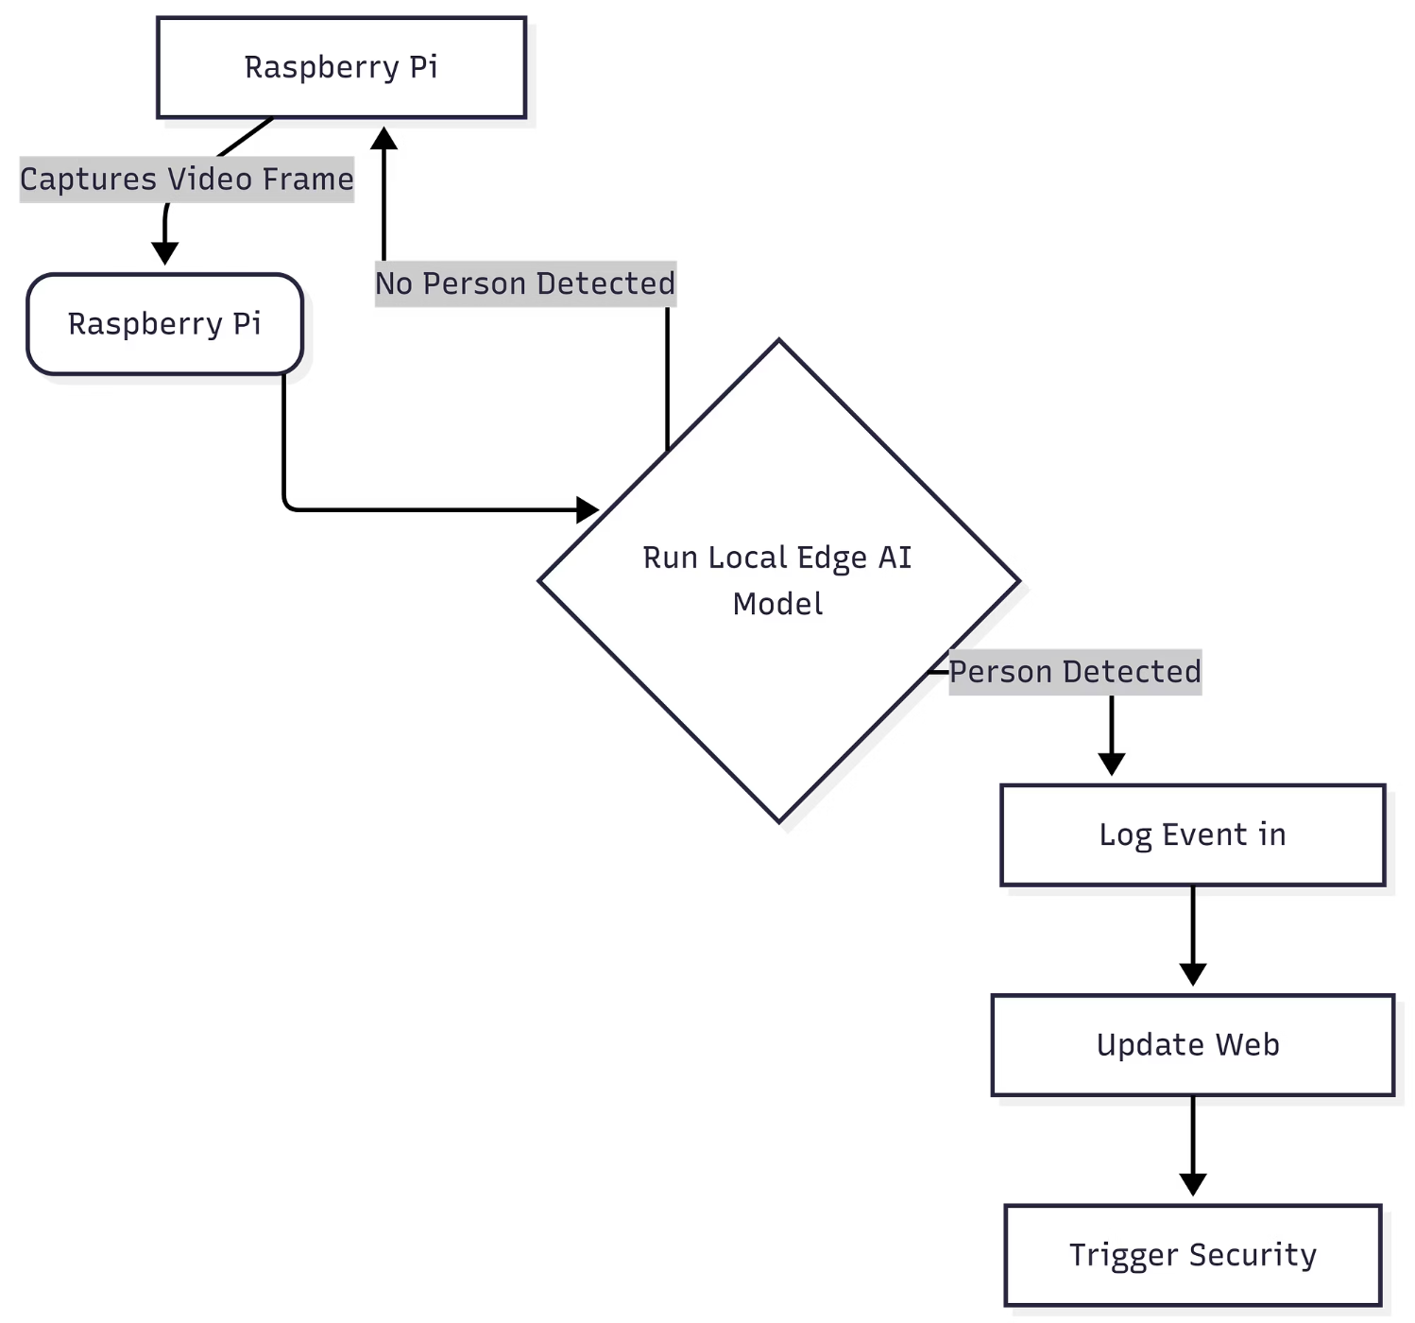
Feature 1: AI Person Detection
This feature leverages local AI to identify individuals, enhancing security without reliance on cloud processing.
Components:
Raspberry Pi 5
Pi Camera Module
TensorFlow Lite (software)
Local AI inference engine

Slide 5
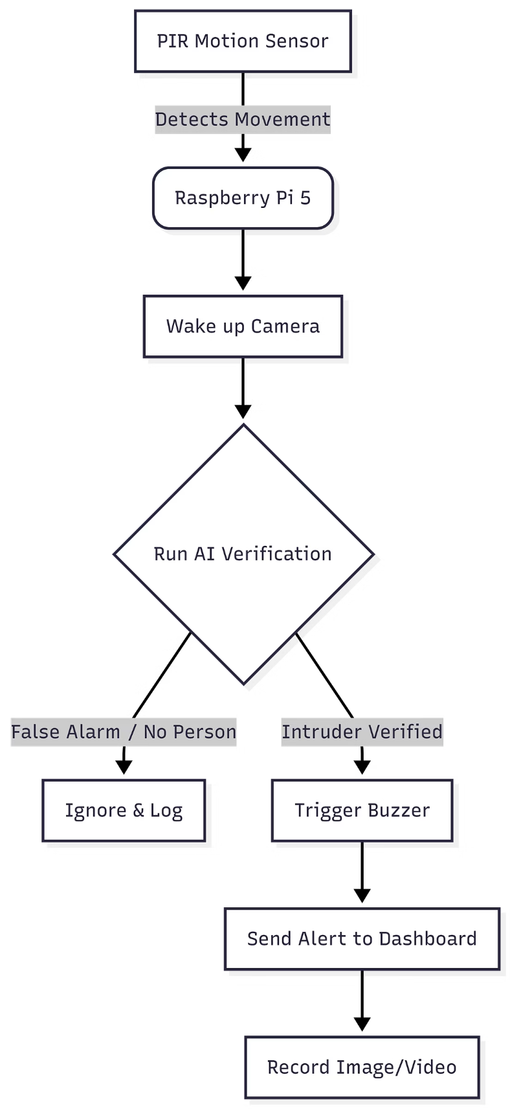
Feature 2: PIR Intrusion Detection
PIR Intrusion Detection uses a motion sensor to detect movement and alert the Raspberry Pi. It provides a simple, reliable way to trigger security responses when someone enters the area.
Components:
PIR Motion Sensor
Raspberry Pi 5 (GPIO pins)
Jumper wires
Pull-up resistor (10kΩ)

Slide 6
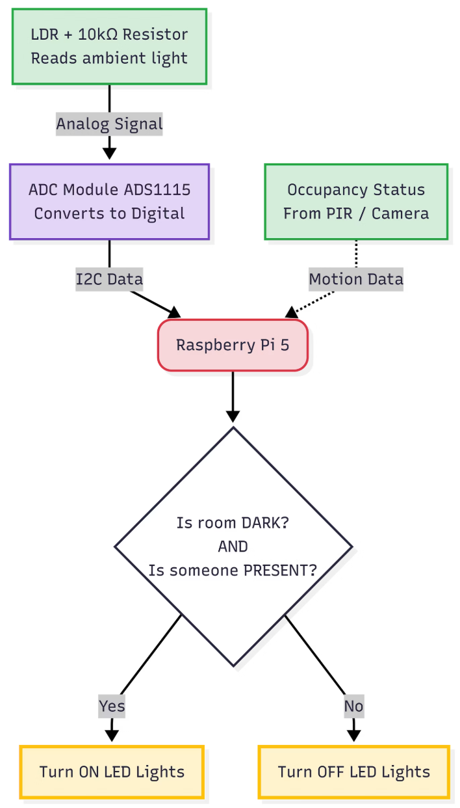
Feature 3: Smart Lighting
Smart Lighting automatically adjusts LED lights based on ambient light and occupancy to improve comfort and energy efficiency.
Components:
LDR (Light Dependent Resistor)
ADC Module (ADS1115)
LED Lights
Resistor (10kΩ)
Raspberry Pi 5 (I2C pins)
Jumper wires

Slide 7
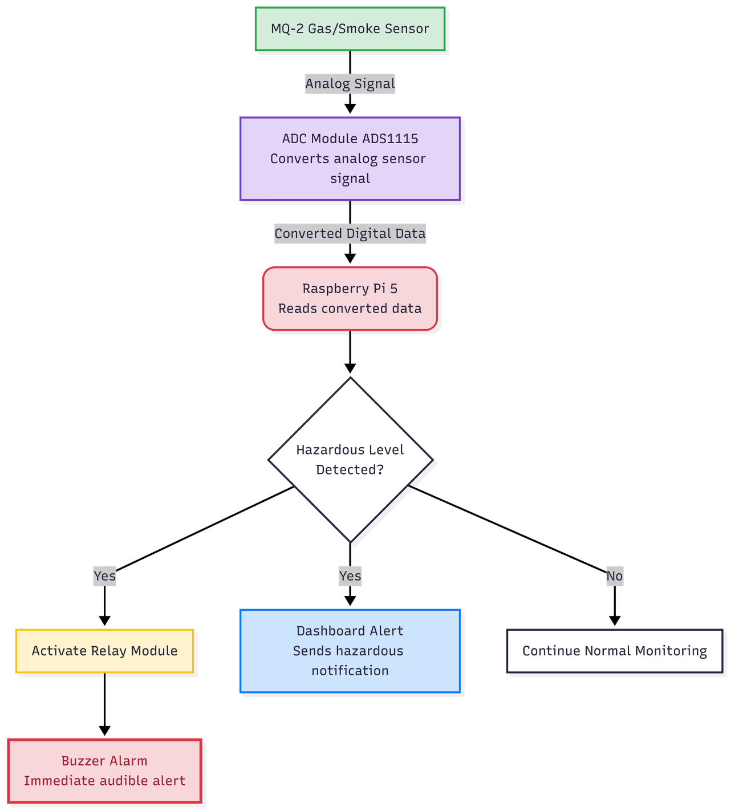
Feature 4: Gas/Smoke Emergency Detection
Detects hazardous gas or smoke levels and triggers an immediate buzzer alert, while notifying the dashboard so action can be taken quickly.
Components:
MQ-2 Gas/Smoke Sensor
ADC Module (ADS1115)
Buzzer (5V)
Relay Module
Raspberry Pi 5 (I2C and GPIO pins)
Jumper wires

Slide 8
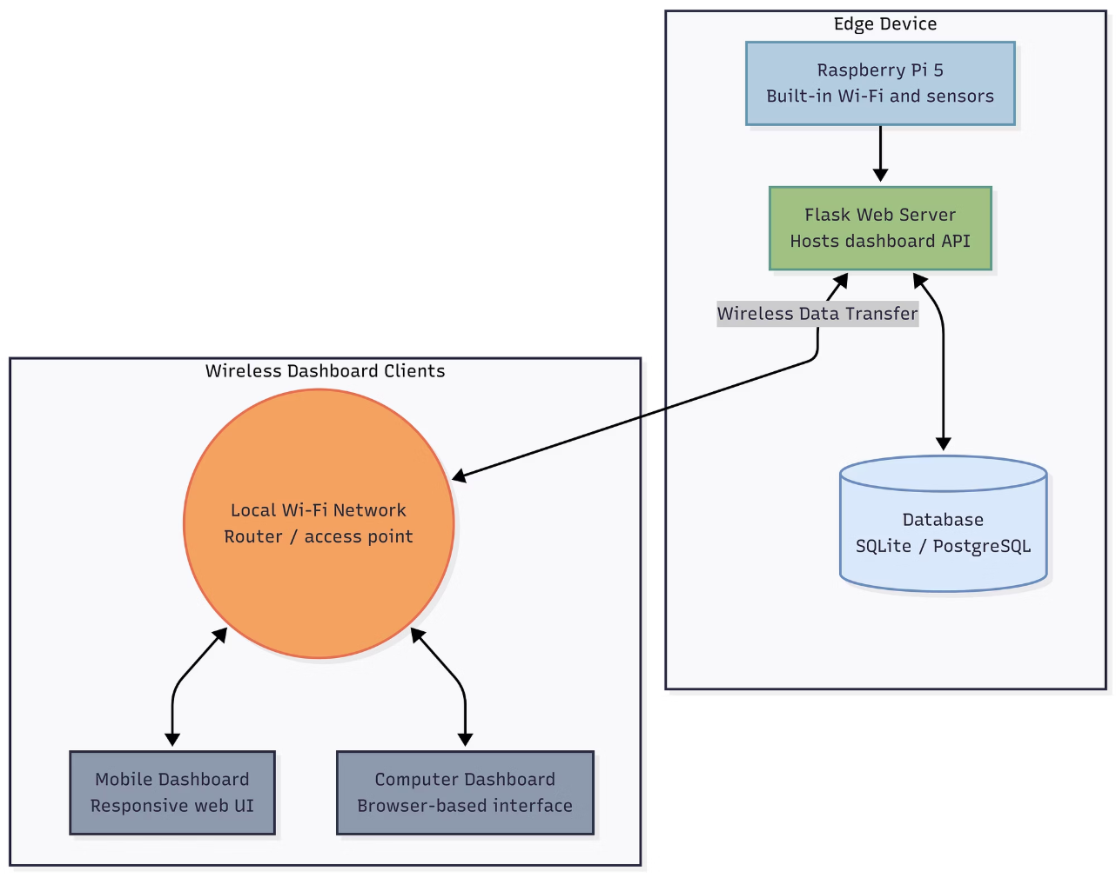
Sub-feature 5: Wireless Dashboard
Wireless Dashboard sends sensor data from the Raspberry Pi to a web-based interface for real-time monitoring and control.
Components:
Raspberry Pi 5 (built-in Wi-Fi)
Web Server (Flask/Django)
Database (SQLite/PostgreSQL)
Network Router
Client devices (computer, smartphone, tablet)

Slide 9
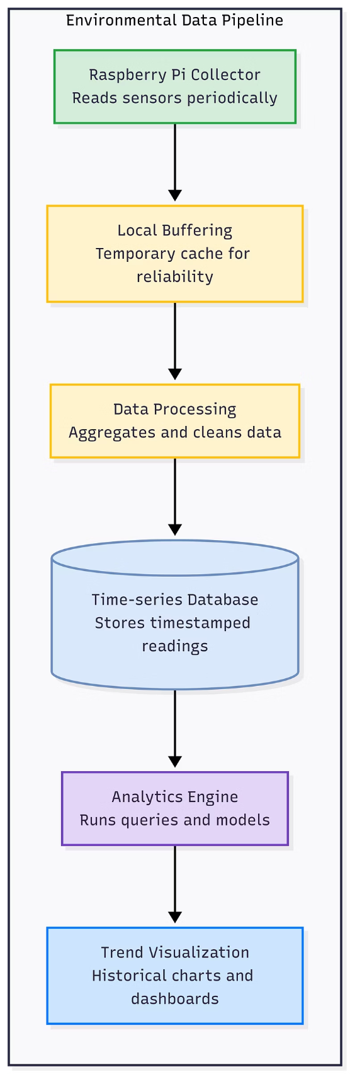
Sub-feature 6: Data Logging & Analytics
Logs sensor data over time and stores it for historical analysis and trend tracking providing a comprehensive overview of environmental data, allowing for informed decision-making and proactive adjustments.
Components:
Raspberry Pi 5
Database (SQLite/PostgreSQL)
Data logging software
Analytics engine
Historical data storage
Trend visualization tools

Slide 10
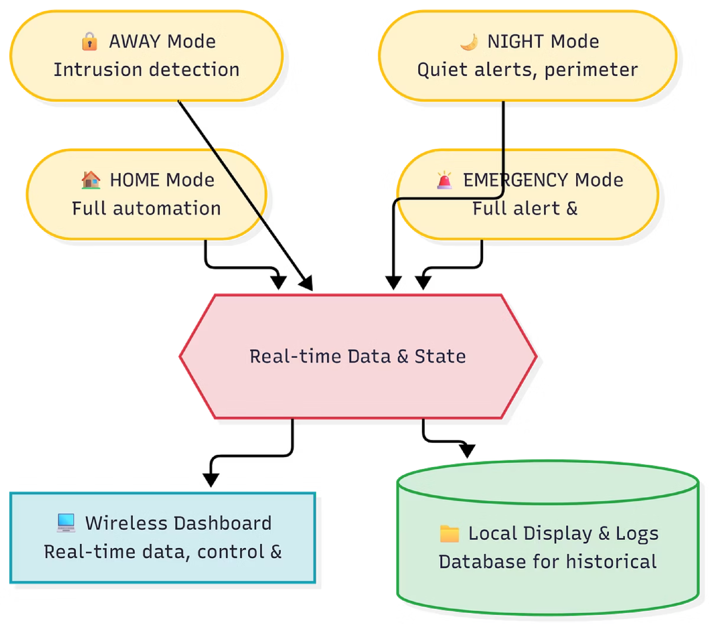





Sub Feature 7: System Modes & Data Analytics
HOME
Full automation active, all sensors monitoring
AWAY
Enhanced security, intrusion detection priority
NIGHT
Reduced lighting, quiet alerts, perimeter active
EMERGENCY
Full alert: buzzer, dashboard notification, ventilation
Wireless Dashboard
Local Display & Logs
Web-based Wi-Fi interface for real-time data, control, and alerts
I2C OLED for local readout; database for historical environmental and security analytics

Slide 11
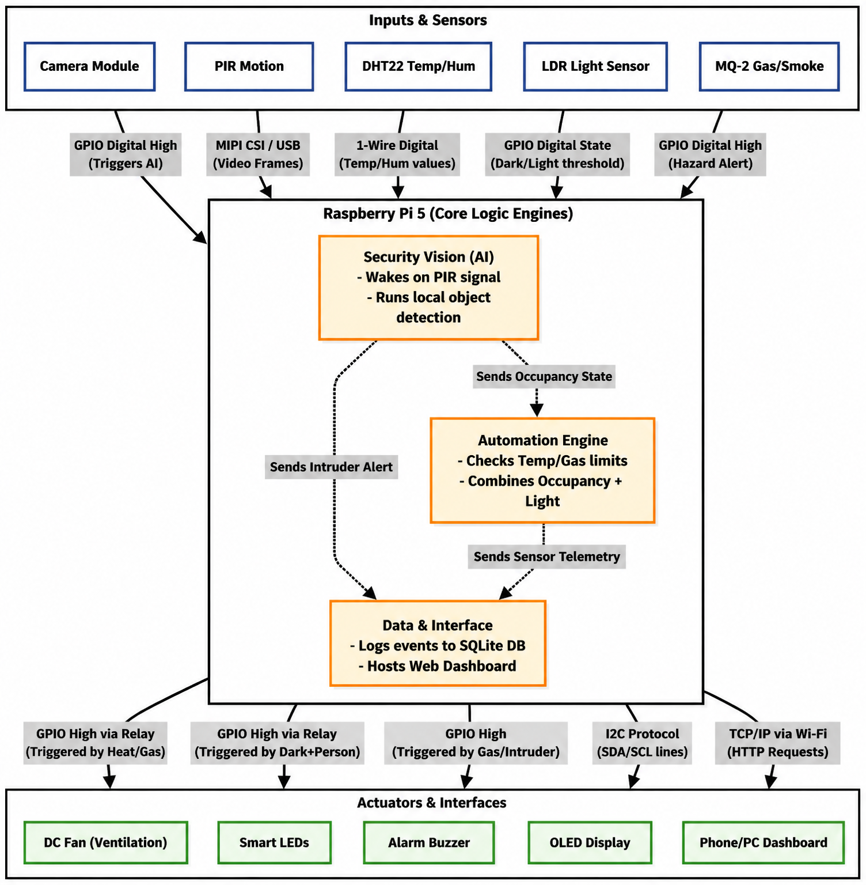

System Architecture Diagram
Inputs
Sensors: PIR, DHT22, LDR, MQ-2, Pi Camera
Processing
Raspberry Pi 5 — edge AI inference, logic, and data logging
Outputs
Servo, DC Fan, LEDs, Buzzer, OLED, Web Dashboard

Slide 12




Required Components
Core
Sensors
Raspberry Pi 5
Pi Camera Module
PIR — Motion
DHT22 — Temp/Humidity
LDR — Light
MQ-2 — Gas/Smoke
Actuators & Outputs
Supporting Hardware
SG90 Servo motor
5V DC Fan
LEDs & Buzzer
0.96" I2C OLED Display
Breadboard & jumper wires
Resistors
External power supply
Prototype enclosure

Slide 13
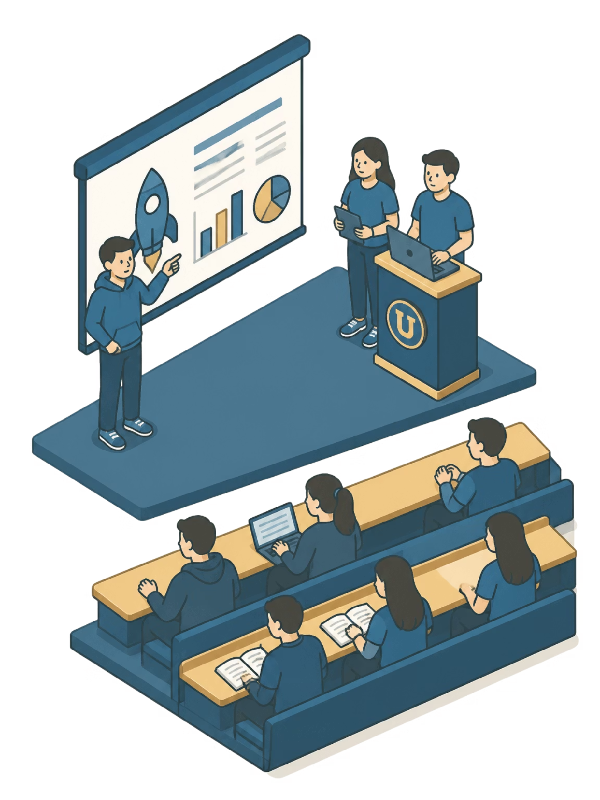
Conclusion
Thank You
Questions?
We appreciate your time and attention throughout this proposal presentation
We welcome your feedback, suggestions, and academic guidance

